Slide 1
Software Engineering
Chapter 4

Slide 2
User Interface design (UI-design)
The interface shown to the user
The most important aspect of the software
User does not want to know how everything is put together
User wants to know how to use it
Important
Easy to learn
Easy to use
Simple to navigate

Slide 3
Interface design
A combination of computer science, psychology, sociology, ergonomics
Who works with the system?
What information should the user see?
How does the user learn?

Slide 4
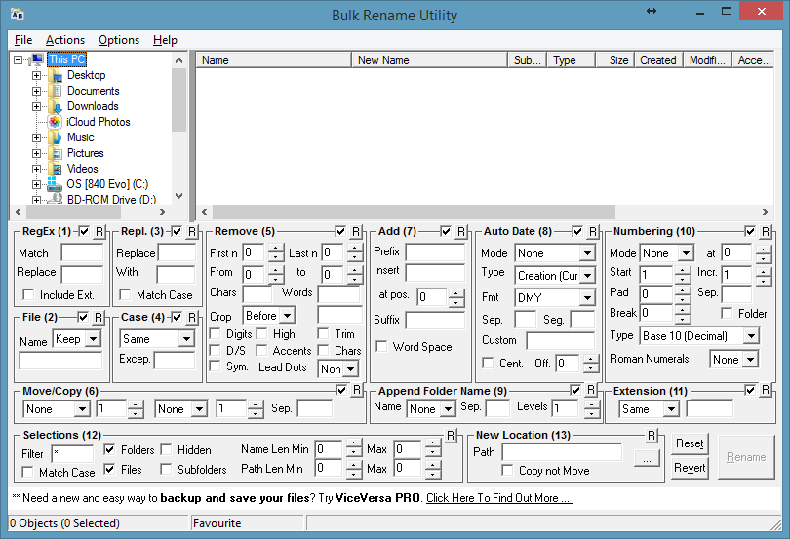
How best not to

Slide 5
user interface
Three types
Command Line
Menus
Graphical
Depending on
Application
Users
Each type has its advantages and disadvantages

Slide 6
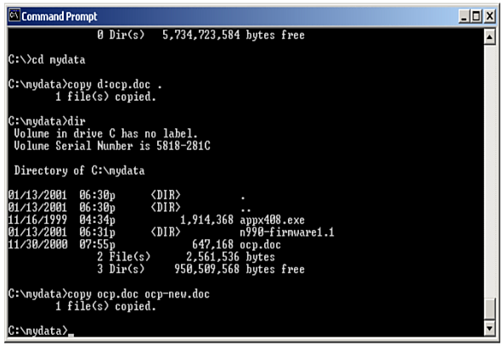
Command Line Interface
Simple view
Unambiguous commands, unforgiving
Text only
Experienced users (only)
Notes:
CLI : del c:\file.txt

Slide 7
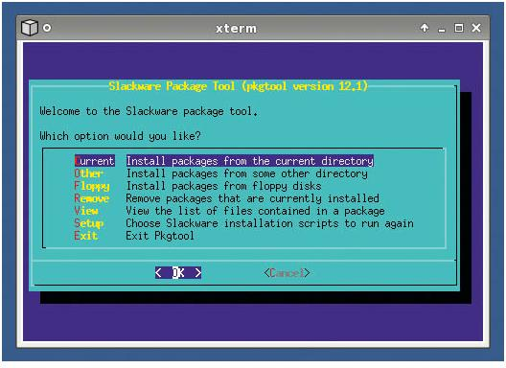
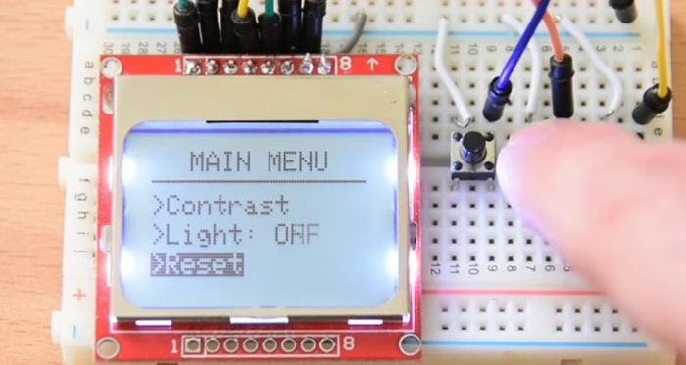
Menu Interface
Two types
Console-like
Embedded display
Notes:
Menu interface:
To delete the file, key D
To display the file, key L
To open a file, key O
To save the file, key S

Slide 8
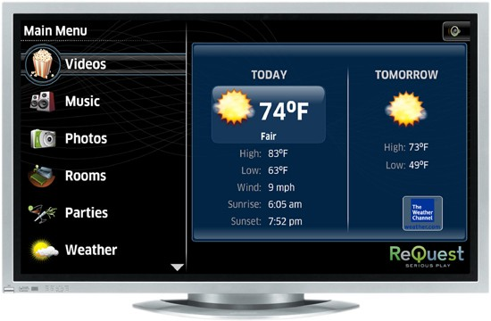
Graphic Interface
Controllable with mouse and keyboard
Icons
Buttons
Notes:
GUI:
relatively easy to learn and use
use multiple windows for system interaction (CMD/CTRL-C in 1 window and CMD/CTRL-V in another window)
fast, full-screen interaction
different types of information can be displayed simultaneously, enabling the user to switch context
the use of graphical icons, pull-down menus, buttons and scrolling techniques reduce the amount of typing.

Slide 9
Next evolution
Natural User Interface
Virtual Reality
Augmented Reality
https://www.youtube.com/watch?v=SeiJ2jHyy7U

Slide 10
Users' perspectives
End User reacts to new SW, based on past experiences
Similar problems => similar solutions
But different end users => different actions as humans are unique.
Novice or occasional user vs Experienced user
Domain in which end user works

Slide 11
Principles and guidelines
Principles
Generic
At a high level
More difficult to implement
E.g. ensure consistency throughout the system
CRAP-design,
Make it obvious
Guidelines
Specifically
Detailed
Easy to implement
E.g. Black text on white background is more readable than white text on black background
Notes:
Principle: Make sure buttons always look the same and are in the same order.
CRAP: Contrast, Repetition, Alignment, Proximity

Slide 12
Design principles
Classifiable into three groups
Learnability
Flexibility
Robustness
Notes:
Learnability: How easy is it to learn the interface
Flexibility: Are there different interaction options? (menus and buttons or shortcuts)
Robustness: Is there sufficient feedback to the user?

Slide 13
Learnability
How easy is the interface to learn?
Predictable
Feedback
Trusted
Generalizable
Consistent

Slide 14
Flexibility
Does the interface support different types of interactions?
User initiative
Multithreaded
Tasks migratable between user/system
Alternative solutions
Customizable
Notes:
Migratable tasks: email client that automatically replies on vacations
Alternative solutions: font selectable via menu or direct typing
Customizable: hide menu bars, create macros, ...

Slide 15
Robustness
Is the user getting feedback on what he is doing?
Observable
Restorable
Responsiveness
Notes:
Observable: Showing information that is useful to the user to let him know what is going on
Restorable: Can the user undo things? E.g. via Undo button, ask when deleting file
Responsiveness: Speed at which the system responds: two characteristics, length and deviation from mean

Slide 16
Other examples of principles
Ensure that users cannot make mistakes
Don't make users remember unnecessary things
Maximize productivity
Notes:
No mistakes: Place buttons etc. far enough apart so that the wrong button cannot be pressed accidentally.

Slide 17
Design guidelines
Detailed and specific advice
Describe what the application should look like
Ensuring consistency within an application or between different applications
E.g. make sure that commands that are not relevant in the current context cannot be clicked on
E.g. a Windows application always has a cross at the top right to close the application
A button is a button

Slide 18
CRAP

Slide 19
CRAP principles
Contrast
Letter-sizes, colours, letter types (sans/sans-serif), bold/italic/normal/underlined
Repetition
Common themes across pages (headers/footers/navigation)
Alignment
Grid like structure
Proximity
Related items, sit together

Slide 20
Web & App UI-Design 101

Slide 21

Web & App UI-Design 101
Don’t make me think
The obvious
How we really use the web (scan, satisfice, muddle)
Billboard Design 101
Web Navigation
Omit needless words

Slide 22
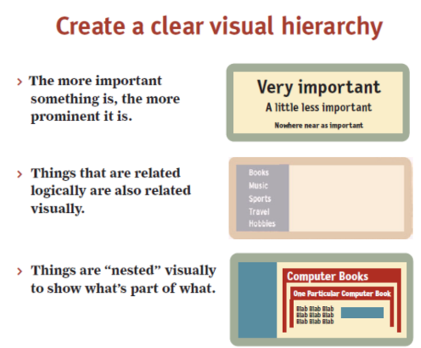
Web & App UI-Design 101: Attention

Slide 23
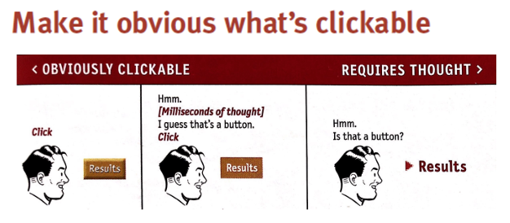
Web & App UI-Design 101: Clickable

Slide 24
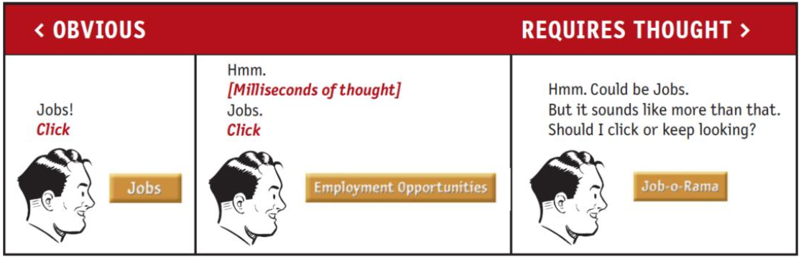
Web & App UI-Design 101: CLEAR

Slide 25
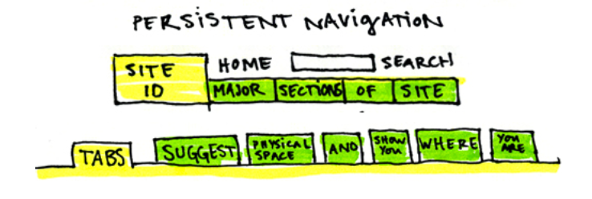
Web & App UI-Design 101: Navigate

Slide 26
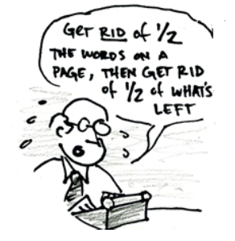
Web & App UI-Design 101 : Simplify

Slide 27
Other UI guidelines

Slide 28
Examples of guidelines
Ask the user to confirm destructive actions (e.g. deleting file)
Provide minimal user input (e.g., minimize the number of mouse clicks)
Group related functions and buttons (e.g. text formatting buttons in Word)
Present data in a way that it can be quickly absorbed (e.g. graphs for trends)
Don't use too many different colours (many people are colour blind)

Slide 29
Usability Specification
To test and evaluate a design
Functional Requirements of the UI (e.g.: needs navigation)
Interaction + navigation options
Learnability
Throughput
Robustness against user error
Recoverability from user error
Adaptability + accessibility
Notes:
Learnability: time to reach a certain level (user should be able to perform 80% of tasks after a 3h training)
Throughput: How quickly a user can complete tasks
Adaptability: How does the interface handle tasks that were not anticipated in advance

Slide 30
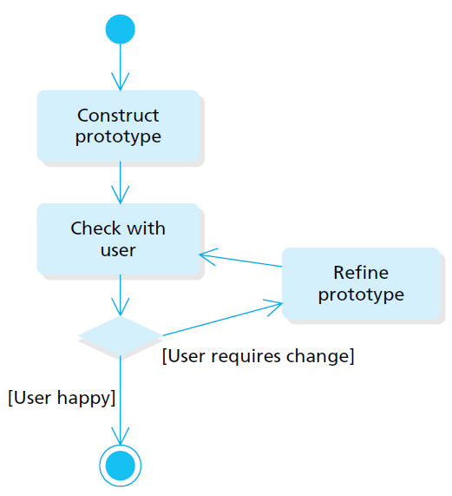
Prototype
Designer creates
User tests and provides feedback
Designer customizes
Iterate until design is approved

Slide 31
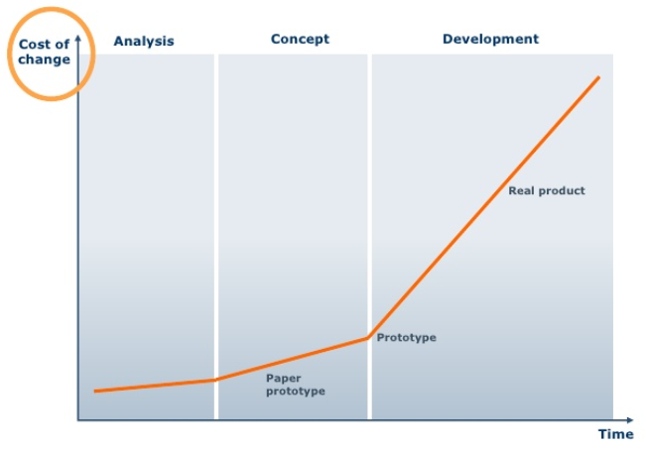
Usefulness of prototype Iteration
1 user testing early in the project is better than asking 50 users to test at the end

Slide 32
Evaluation
User observation
Video recordings
Tracking software
Spoken feedback
Survey

Slide 33
HELP system

Slide 34
Help system
Most used guidance for users
As important as the software itself
Usually consists of three parts
Feedback on user interaction
Online help system
Included documentation

Slide 35
Help system
Feedback
Short
Constructive
Visual
Polite

Slide 36
Help system
Online help and included documentation
Should these be equally comprehensive?
How do you open the help?
How do you read these?
How much information should the user see?

